Slide 2
ROLES OF VIETNAM NURSES ASSOCIATION IN POLICY ADVOCATING
PAST SUCCESSES AND CURRENT CHALLENGES
Pham Duc Muc, President of Vietnam Nurses Association
Tran Quang Huy, Vice President of Vietnam Nurses Association

Slide 3
CONTENTS
Context of Nursing Profession in Vietnam
Mile stones in policy advocating for professional development
Current challenges
Recommendations

Slide 4
  1. CONTEXT OF NURSING PROFESSION IN VIETNAM (1)
BEFORE 1975
IN THE NORTH
Nurse = Y TÁ (Enrol & Secondary)
Training: 2,5 years
No management system
No Nurse Associaton
IN THE SOUTH
Nurse – ĐIỀU DƯỠNG
Training: 3 years
Nursing Devision in MoH
Nurses Association
SINCE 1975 – 1989
Nurse = Y TÁ/ ĐIỀU DƯỠNG
Training: 2,5 years
No nursing managment position at MoH and PHB
No Nurses Association

Slide 5
  1. CONTEXT OF NURSING PROFESSION IN VIETNAM (2)
Since: 1990 -2005
Nursing management: established and developed
Training: College and University levels
Proposal to rename: Y TÁ ➔ ĐIỀU DƯỠNG: NO SUCCESS
Nurses were not rewarded the title: “EXCELENT PHYSICIAN”
No Salary Promotion Policy for nurses upgraded to college level (1997-2005).
Since: 2006 - Present
1) Training: Two levels added:
Master/Specialty level I and Doctoral Degree;
2) Rename:
Y TÁ ➔ ĐIỀU DƯỠNG: SUCCEEDED;
3) Nurses were rewarded the title: “EXCELENT PHYSICIAN”

Slide 6
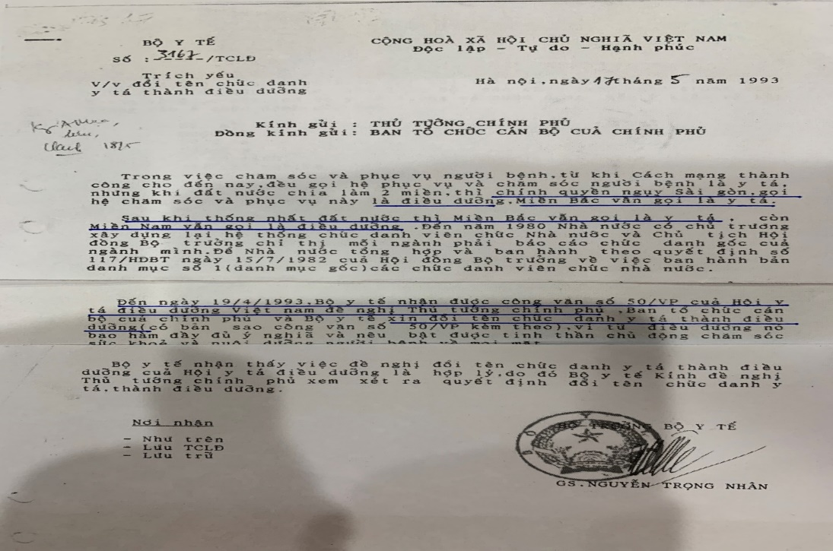
  1. CONTEXT OF NURSING PROFESSION IN VIETNAM (3)
  17.5.1993: PROPOSAL TO RENAME: ĐIỀU DƯỠNG

Slide 7
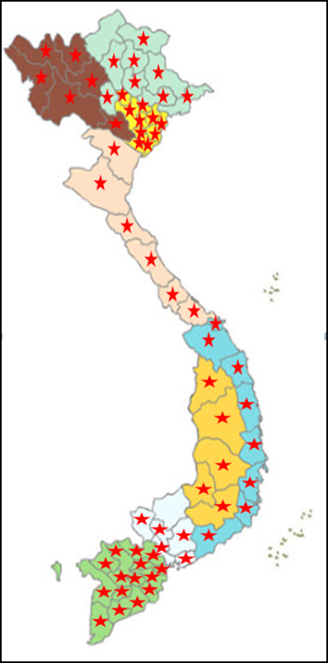
  2. MILE STONES IN NURSING PROFESSION DEVELOPMENT (1)
HỘI ĐIỀU DƯỠNG:
ESTABLISHED: 26.10.1990
English name: Vietnam Nurses Association (VNA)
Membership: Nurses, Midwives, Lab Technicians
Missions: for the profession, for members and for the public health.
Vision: presentive of the voice of Vietnam Nurses, responsible for policy advocating to develop nursing profession in Vietnam
NETWORK
VNA AT PRESENT
Head Quater Office: Cung Trí thức Hà Nội
Electronic Website: https://hoidieuduong.org.vn
Organization: 3 levels; 61 Provincial Branches; 03 Specialty Branches: Nurses Teacher Branch – VNTB, Surgical and Pediastric); 800 subassociations; App: 150.000 members)
Vietnam Nursing Journal
Training and Consultation Center
61/63 Province

Slide 8
  2. MILE STONES IN NURSING PROFESSION DEVELOPMENT (2)
VNA – POLICY ADVOCATING
1990: Set up Nursing Office in Hospitals
1992: Set up Nursing Office in MoH
1993: Rename: Y TÁ ➔ ĐIỀU DƯỠNG
1997: Rename Hội Y TÁ ➔ HỘI ĐIỀU DƯỠNG
1999: Allocate chief nurse position in PHB
1999: Initiate nursing research (Regular national nursing research forum)
2005: Salary policy amendment
2007: Reward the title: EXCELLENT PHYSICIAN for NURSES
2012: ENACT Basic NURSE COMPETENCIES STANDARDS
2013: ENACT NURSE ETHICAL STANDARDS
2020: Develop training curriculum for CARE GIVER.

Slide 9


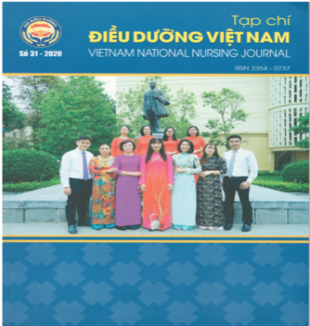


  2. MILE STONES IN NURSING PROFESSION DEVELOPMENT (3)
2002 - PRESENT
1993 - PRESENT
2000- PRESENT
1999

Slide 10
  3. CURRENT CHALLENGES
1. Serious shortage of nurses in hospitals: Patients have not been provided the best quality of nursing care;
2. Policies for nursing profession: lack a synchronous connection between training, employment and remuneration;
3. Lack a unified orientation for the nursing management system of specialized hospitals and district hospitals.

Slide 11
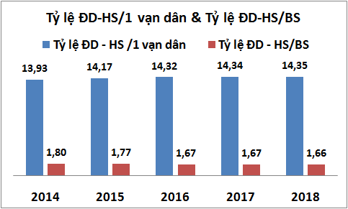
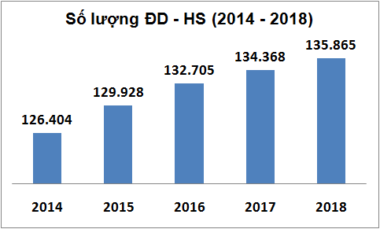
  3. 1. CURRENT CHALLENGES: NURSE RESOURCES INDICATORS
Nurses/10.000 population: 14,35 (2018); Target (2025): 25 ĐD/1 [3, 4 and 9 times LOWER THAN Thailand, Malaysia and Japan respectively)
Nurse/Doctor: Decreased from 1,80 down 1,66 (2014-2018).
Source: MoH, annual statistical data : 2014-2018

Slide 12
  3. 2. LACK A SYNCHRONOUS CONNECTION
EMPLOYMENT | TRAINING | SALARY/RENUMERATION
No SOP (Advance Nursing Practice ) |  | 1st Degree (Not yet)
 |  | 2nd degree (±)
SOP: NOT CLEAR CUT |  | 3rd degree
 |  | 4th degree
PhD
Master/CK1
UNIVERSITY
COLLEGE
2005: Added 2015: Remove)
SECONDARY
Need to approve and apply SOP corresponding with level of training
The first degree as well as salary scales for nurses holding this degree should be added

Slide 13
  4. RECOMMENDATIONS

Slide 14

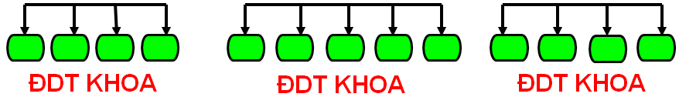

  1. MAINTAINE AND DEVELOP NURSING MANAGMENT SYSTEM
MoH
ROAD MAP OF NURSING MANAGEMENT SYSTEM DEVELOPMENT
MSA
1993
Nursing office
PHB
Chief Nurse
1999
Nursing Office
CENTRAL HOSPITAL
Nursing Office
PROVINCIAL HOSPITAL
Nursing Office
DISTRIC HOSPITAL
1990
1982
Reconsider to the policy to merging nursing office in specialized hospitals and distric hospitals
Empower Nurse Managers in co-ordination nursing care management
ĐDT KHOA = WARD NURSE MANAGEMENT

Slide 15
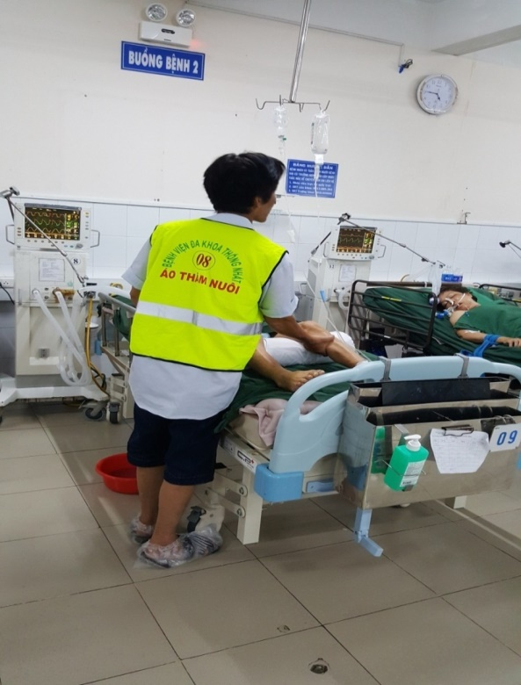
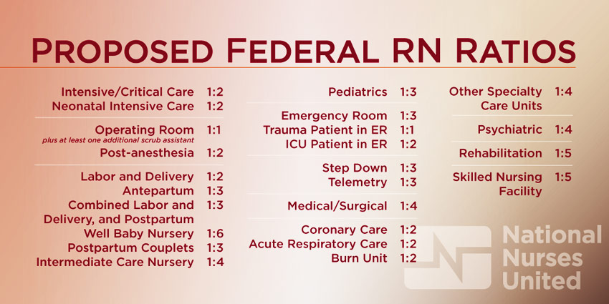
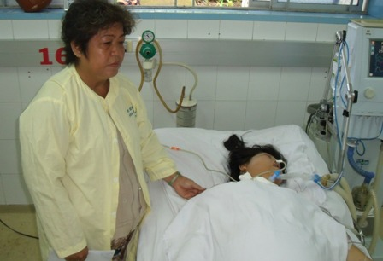

2. CONSTRUCT REASONABLE NURSING SERVICE PRICE ON BED DAY
Develop reasonable construction of nursing service price on bed day
Develop mechanism to pay for nursing service provided to patients to allow hospitals to recruit more nurses to give comprehensive care to patients.

Slide 16


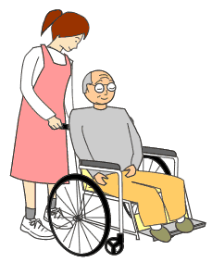
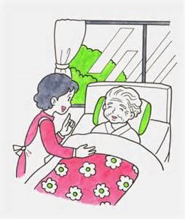
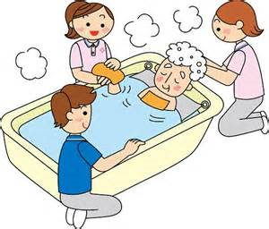
2. CONSTRUCT REASONABLE NURSING SERVICE PRICE ON BED DAY
C1
C2
C3
C4
C5
Aging society and chronic disease patterns balance TREATMENT & CARE.
A quality health system cannot rely solely on treatment.
In other countries: Fees for bed day are mainly paid for care services of nurses.
Key Message:
“NEED TO CONSTRUCT THE BED-DAY PAYMENT MECHANISM SO THAT THE PATIENTS CAN ENJOY THE BEST NURSING SERVICES
Notes:
16

Slide 17
SUMMARY
The VNA has tried its level best to successfully mobilize many important institutions to pave the way for the development of nursing profession. In the coming time, the VNA recommends the Government Management Agencies to pay further attentions to 4 following issues:
Increase nursing human resource to achieve the target: 25 nurses/10 populations in 2025;
Inact SOP corresponding to level of training of nurses; Add the FIRST degree to the nurse professional ladder.
Maintain the nursing management system and Empower nurse manager to co-ordinate nursing care activities as it is in private hospitals or in other countries.
Develop mechanism to pay for nursing services in order to allow hospitals to recruit more nurses to give comprehensive care so that the patients receive the best quality of nursing care.

Slide 18


